Slide 1


MICROSOFT POWER BI DATA ANALYSIS
Final Project
Super Store Sales
Data Insights
Prepared by Team 2
Sondos Essam
Abdulla Mohamed
Amr Nagy
Josef Gerges
Abdulla Selim
Supervise
Eng: Ahmed Megahed

Slide 2

Project Overview and Objectives

Slide 3
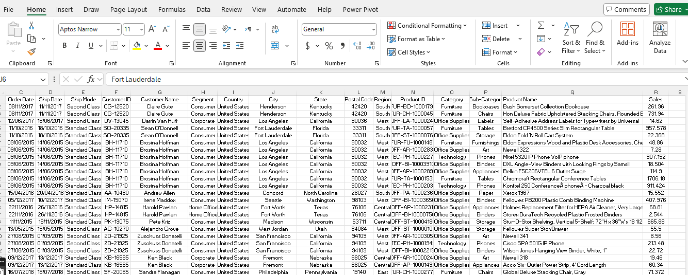
Dataset
Overview
Total Records: 9,800 rows
Total Columns: 18 fields
Data Types
Numerical: Row ID, Postal Code (some float), Sales
Textual/Object: All other columns

Slide 4
Data Cleaning & Transformation
Missing Data
Only Postal Code has missing values (11 entries)
Date Format Inconsistencies
Some dates are written like 8/11/2017 (Month/Day/Year) — which looks like U.S. format.
Others are like 13/05/2015 (Day/Month/Year) — which looks like European format.
Encoding Issues (Special Characters)
Some products have strange characters like Â inside the name.
Konftel 250 ConferenceÂ phoneÂ - Charcoal black
ImationÂ 8GB Mini TravelDrive USB 2.0Â Flash Drive
Precision Issues (Sales Amount)
"Sales“ some super detailed like 957.5775, while others are rounded like 22.368 or 68.81.
Not necessarily a "mistake," but in a clean dataset, you would want consistent decimal precision

Slide 5
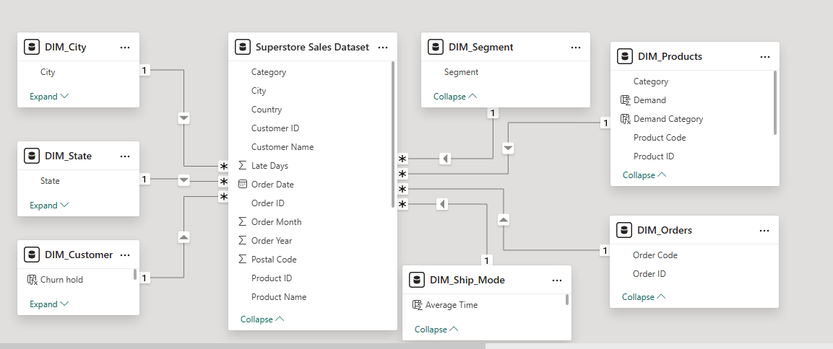
Modeling

Slide 6
breakdown of what questions we should ask
📊 About Sales Performance:
🚚 About Shipping:
What is the total sales revenue?
Which month or year had the highest sales?
Are sales growing or dropping over time?
Based on past sales trends, what are the expectations.
How many days does it take between Order Date
and Ship Date?
Are there delays in shipping?
Is faster shipping related to better sales or higher
customer satisfaction?
🛍️ About Products:
Which category/sub-category performs best?
Which products are selling the most?
Which products have low sales but high price?
🗺️ About Geography:
Which city/state generates the highest sales?
Which states or cities are underperforming?
👤 About Customers:
Are there loyal customers with multiple purchases?
Which customers have the highest lifetime value?
Are there customer segments based on location, buying behavior, or order size?

Slide 7

Data Insights

Slide 8

Key Insights

Slide 9
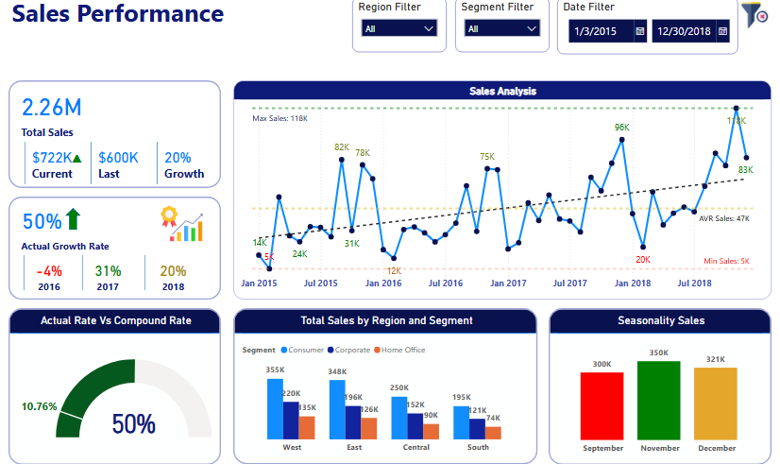
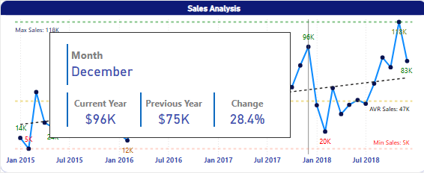
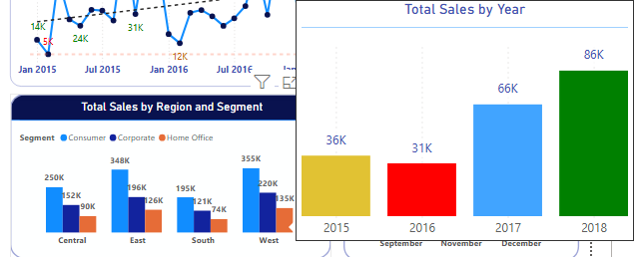
Data Insights
Sales Tooltip

Slide 10
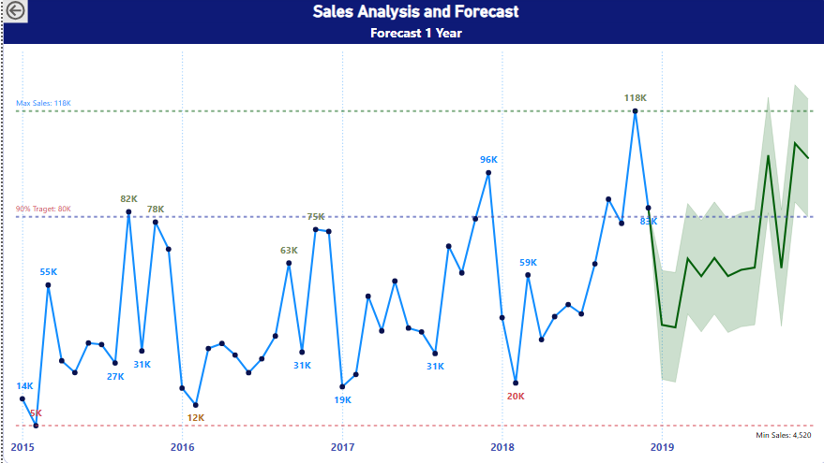
Data Insights

Slide 11
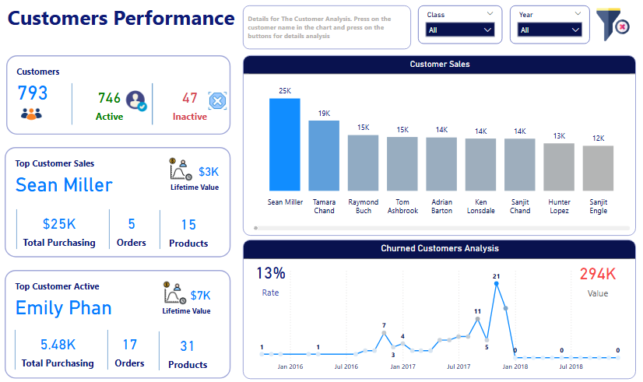
Data Insights

Slide 12
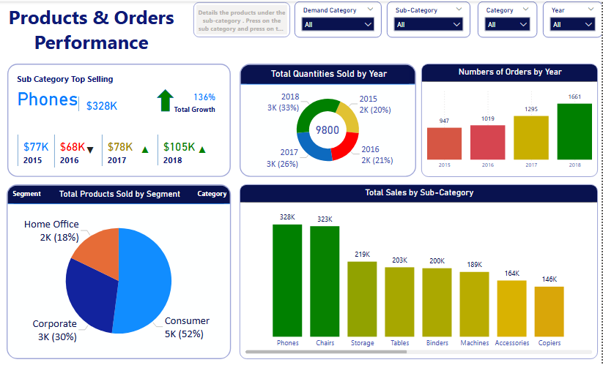
Data Insights

Slide 13
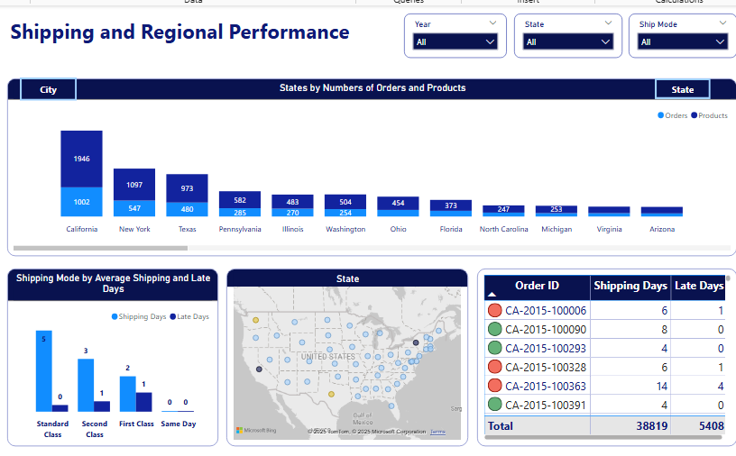
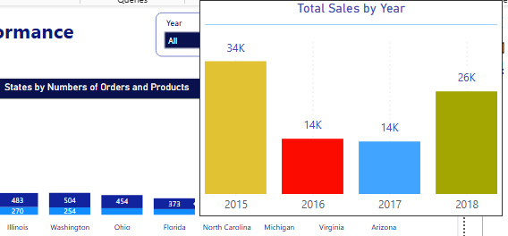
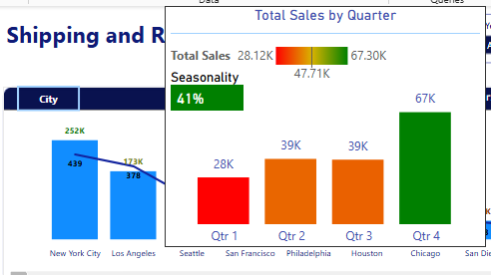
Data Insights
Shipping and Regional Tooltip

Slide 14
THANK YOU !

